Slide 1

The Ethics and Economics of Environmental Protection
5. Economic principles and their applicability to environmental questions

Slide 2
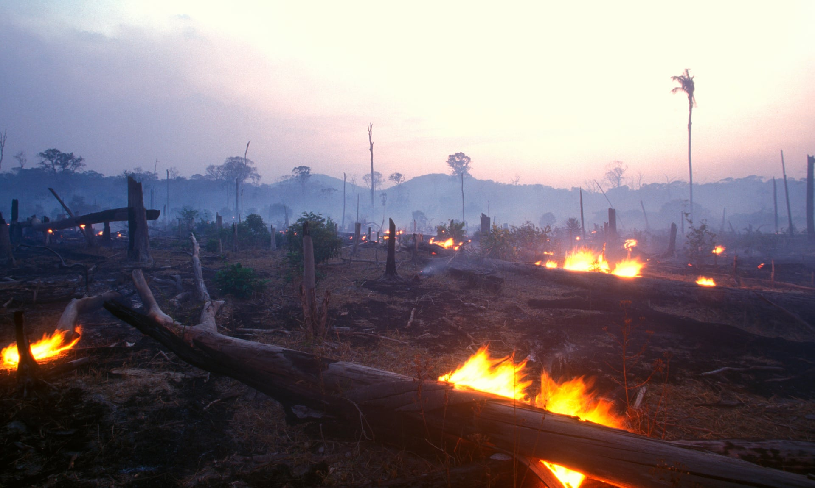
Prelude: The other-worldly confidence of the economist
On Tuesday the Treasury launched the Dasgupta Review (called The Economics of Biodiversity)
The headline? That biodiversity and environmental losses are a failure of economics (not a failure of the human imagination, or even of “politics” or “society”)
Economists’ measures of wealth misvalue (or undervalue) biodiversity: “nature” (or its goods, services, and sinks) should be included in economic models
National policies are therefore unsustainable, and should be updated to recognise the costs of human activity (i.e., growth)
  The costs of agriculture must be properly accounted
  Population growth must be limited
  Environmental economics must be central to education
  International environmental resources should receive a rent

Slide 3
1. Utilitarianism: a recap
Utilitarianism entails the principle that we should act so as to maximise utility, or well-being
  Specifically, social practices should maximise the welfare of the average individual
Utiltarianism entails a set of controversial ethical commitments
  Consequentialism
  Rationalism
  Welfarism
If 1 – 3 are accepted, then:
  Utilitarianism as interpersonal neutrality
Run into philosophical objections
Runs into moral objections

Slide 4
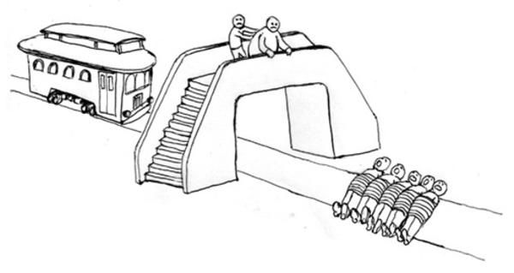
Moral objections, acts, and rules
Interpersonal utilitarian neutrality may be morally outrageous
  E.g., the (in)famous “trolley problems” we touched on last week
Utilitarians may respond to this objection in two ways
  By biting the first-order bullet (act utilitarianism)
  By applying utilitarianism as a second-order principle (rule utilitarianism)
Rule utilitarianism allows us to incorporate social ethics into our moral principles
  For instance, people may be given “rights” to protect them from others’ act-utilitarian instincts (e.g., those of the doctor seeking to harvest your organs)
  More generally, we might seek to promote “higher order” or more socially desirable utilities (e.g., those that promote environmental flourishing)

Slide 5

Rules, acts, and economics
Economics might be seen as a form of rule utilitarianism applied to resource allocations
  Given the basic fact of scarcity, economists are concerned to generate mutually beneficial forms of social cooperation
  E.g., neoclassical economists emphasise the benefits of mutually beneficial exchange
Economists agree that cooperation must be shaped by social institutions
  Incentive effects (collective action problems and free riding)
  Information effects (ignorance and learning)
Note the key debate over who has more (less) knowledge: agents in the market or the state?

Slide 6

2. Which kind of economist are you?

Slide 7
Sheepish vs. wolvish economics
↓ Views of… | Neoclassical Interventionism | Neoliberal Decentralism
Economic actors | Sheep | Wolves
Incentives | Material | Cultural
Knowledge | Objective (costs and benefits) | Subjective (potential mutual gains)
Environmental problem | Imperfect prices | Incomplete prices
Environmental solution | Centralised policies | Decentralised discoveries
Political economy | Market failure | State failure
Examples | Pigou, Samuelson, Jacobs, Dryzek | Hayek, Anderson and Leal, Ostrom

Slide 8
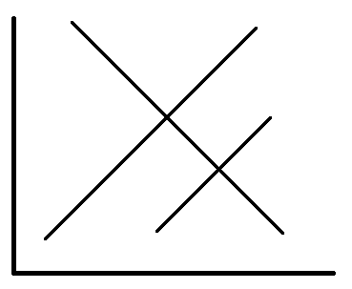
A) Externalities and market failure
Environmental harm occurs when prices do not properly internalise the costs and benefits of individual choices
Incomplete prices lead to over-consumption of -ve externalities and the under-consumption of +ve externalities
  Excessive pollution and health risks;
  Excessive environmental damage and erosion of ecosystem services;
  Insufficient regard for the habitats and biodiversity that underpins ecosystem service provision;
  Insufficient regard for environmental goods such as amenities and a stable, liveable climate.
This all adds up to the rule:
  Without intervention, markets will realise short-term pleasures at the expense of insufficient investment in long-run welfare
P
SMC
P₂
PMC
P₁
PMB
Q₂
Q₁
Q

Slide 9

Should we fear market failure?
The dominant view in neoclassical economics is that environmental goods are “incentive incompatible”
  Largely consist of “open access resources”
  Consistently impose known-value externalities
  Are “public” goods (i.e., they exhibit non-rivalry and non-excludability)
Given the ubiquity of environmental market failure, state intervention is required to shift allocation decisions back to Pareto optimality
  Efficient property rights (e.g., common fisheries policy)
  Information-efficient regulations (e.g., Control of Pollution acts)
  Pigouvian taxes (e.g., green energy taxes)
  Permits and trading systems (e.g., the E.U.’s ETS)

Slide 10
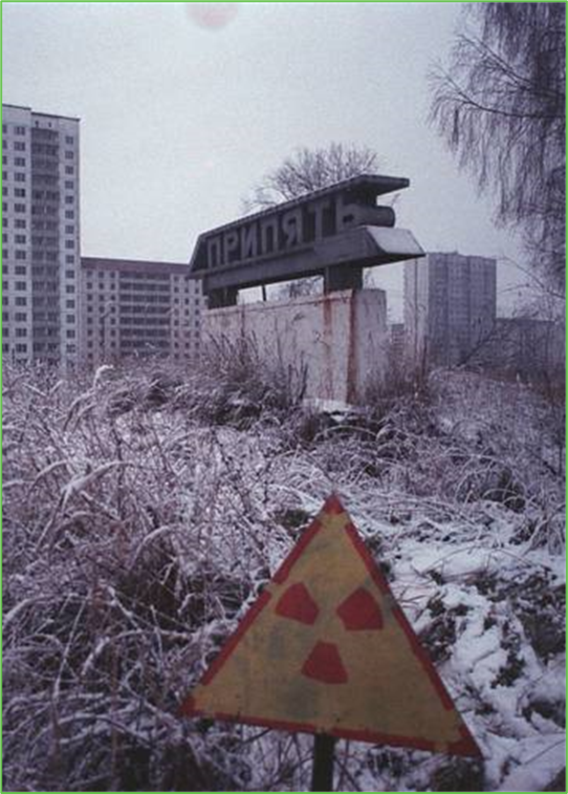
B) Externalities and government failure
Environmental harm occurs when decision-makers are not accountable for their actions
Policy decisions may be particularly dangerous because they assume what must continually be rediscovered
  Neoclassical economics assumes that we know the value of the environment vis-à-vis human purposes
  Environmental policy seeks to encourage (even coerce) people so that they realise the necessary trade-offs
  Liberals assert that we don’t know the value of environmental goods, but must in fact discover it
The neoliberal “tool kit”:
  Environmental policy should prioritise institutional experimentation, competition, and the evolution of organisational forms that match the scale of our environmental problems

Slide 11

Should we fear government failure?
Government agents have access to less information, and face bigger collective action problems, than market actors
  Informationally, policymakers cannot know what the “optimal” price for any good is, or how it should be trade off against other goods
  Policymakers also present a large target for “rent-seeking” special interests
Market decentralisation is necessary to create opportunities for organisational innovation
  Auctions of property rights would allow entrepreneurs to test new ways of “privatising” apparently “public” goods
  “Free market environmentalism” entails competition between different institutional forms which present different ways of assigning responsibility (internalising externalities)
  Liberalism seeks to provide minorities the opportunity to cooperate to secure their own collective goods without having to win elections
Notes:
Emphasise here:
Externalities in politics (e.g., energy policy and Hinkley Point)
Rent-seeking in politics (e.g., polluter interests in the EU and the ETS)
Common pool problems in politics (e.g., environmental standards)
Short-termism in politics (HS2?)

Slide 12
3. End-stuff: I. A comparison of critiques
 | Privatise everything | The man in Whitehall knows best
Humans are stupid | Consumers don’t know enough about the environment—can they spot success if it crops up? | Why should policymakers know any more than consumers? How do they know what institutional forms work across such diverse populations?
Humans are evil | Too many people don’t care about the environment—should they be allowed to discover their own values? | Why assume that people in politics are immune to the motivational problems of wider society? If policymakers are trustworthy, why aren’t buyers and sellers (and vice versa)?
Climate change changes everything | The climate challenge is simply too big to allow for market-based solutions | Could international regulators deal with the massive collective action and coordination problems that would attend a global policy regime? Who would hold them to account?
Notes:
Emphasise here the basic point of the lecture, viz. that economists are divided on the question of what rules are best suited to account for the value of environmental goods. This suggests that there is no self-evidently “best” economic or institutional approach; like the debate from risk and uncertainty, the political economic split between economists reflects different judgements about the consequences of any particular set of property rights and restrictions. Economists who emphasise market failure think that the biggest danger comes from individual error, and so they advocate mechanisms to tax and regulate market participants. Those who emphasise government failure think that markets, though imperfect, facilitate more learning, and allow for more robust solutions to free riding, than centralised policy processes. These economists therefore argue that the best way of dealing with environmental risk is to extend property rights and promote the rights of individuals to exit collective rules. We will explore the pros and cons of these measures after reading week.

Slide 13

II. A note on behavioural economics
Is the problem that people are neither evil nor stupid, but simply weak-willed? (The Greeks called this “akrasia”)
  Preferences are context-dependent (bounded rationality)
  People cannot value or estimate risk (bounded willpower)
  Individuals care about “fairness” as well as/often instead of efficiency (bounded preferences)
When designing environmental interventions, behavioural economics thus suggests the possible need for a new conception of the environmental welfare optimum. …or does it?
This question returns us to the fundamental principled issue raised above: who has more knowledge? Are people sheep or wolves?
  The sheep view: economists can tell that a behaviour is biased (akrasiatic) because they know what the rational answer is
  The wolves view: the economist’s claim from bias is just that—a claim about economics; what people actually think and want, and how “rational” they are, depends on the meanings and information available to them
Notes:
Small clarification: In the lecture I said “the fallacy is that the economist’s notion of rationality just is rationality”. What I meant was, “the fallacy is that the economist’s notion of rationality is treated as if it just is rationality”.

Slide 14

III. Summary
Utilitarianism is controversial—remember, non-economist scholars tend not to like it very much (as demonstrated by their resistance to cost-benefit analysis).
But voters, their governments, and their economics advisors and policymakers, are all thoroughgoing (rule) utilitarians
The benefit of this approach is that it judges utilitarianism by its own (utilitarian) standards: how do we make sure people don’t make stupid hedonistic decisions?
Economists ostensibly present a well of valuable knowledge here, because both the object of their analysis (rational utility maximisation) and their analytical tools (comparative institutional analyses) are perfectly suited for policymaking
Perfect market exchange is the utilitarian ideal, as we saw last week
The question is: does this ideal tell us that the real world is doing admirably well (the neoliberal claim), or that it is doing terribly (the neoclassical claim)?
The answer, we saw, depends on whether you think people are like sheep (so that it would be easy to achieve efficient results) or whether they are like wolves (so that it is surprising that we have done as well as we have)
I also suggested, somewhat stridently, that behavioural economics is unhelpful

